Slide 1
COMP1860 Building our Digital World: Computer Systems & Architecture
S1.W4.L1: Combinational Logic Circuits & Minimisation
Dr James Dyer

Slide 2


Slide 3
Learning Outcomes
Construct a logic circuit using logic gates.
Apply minimisation of Boolean expressions to simplify logic circuits

Slide 4
Text Book
This lecture covers material similar to chapter 12 of Stallings. Computer Organisation & Architecture
  It covers Boolean identities (section 12.1, pages 414 and 415) in greater detail
  It covers sections 12.3, from Multiplexers onward (page 428)

Slide 5
Overview
Implementing Logic Gates in Electronics
Combinational Circuits
  Multiplexer
  Decoder
  Adder
Boolean Algebraic Laws
Expressive Power of NAND

Slide 6
Implementing Logic Gates in Electronics

Slide 7
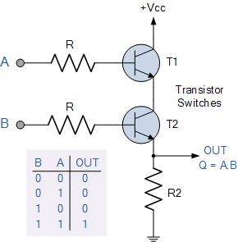
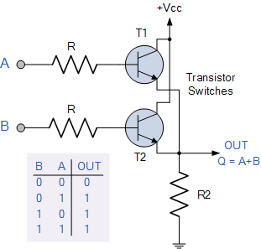
Creating Logic Gates From Transistors
AND Gate
OR Gate

Slide 8
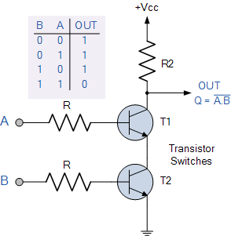
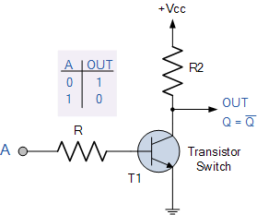
Creating Logic Gates From Transistors
NOT Gate
NAND Gate

Slide 9
Combinational Circuits

Slide 10
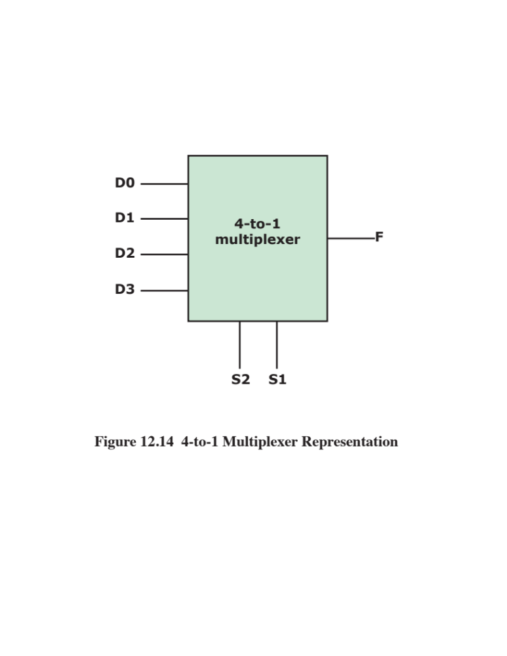
Mutiplexer (MUX)
A multiplexer is a selector
One of the inputs will be output
Which one depends on the selection inputs (S1, S2, etc.)
S2 | S1 | F
0 | 0 | D0
0 | 1 | D1
1 | 0 | D2
1 | 1 | D3

Slide 11
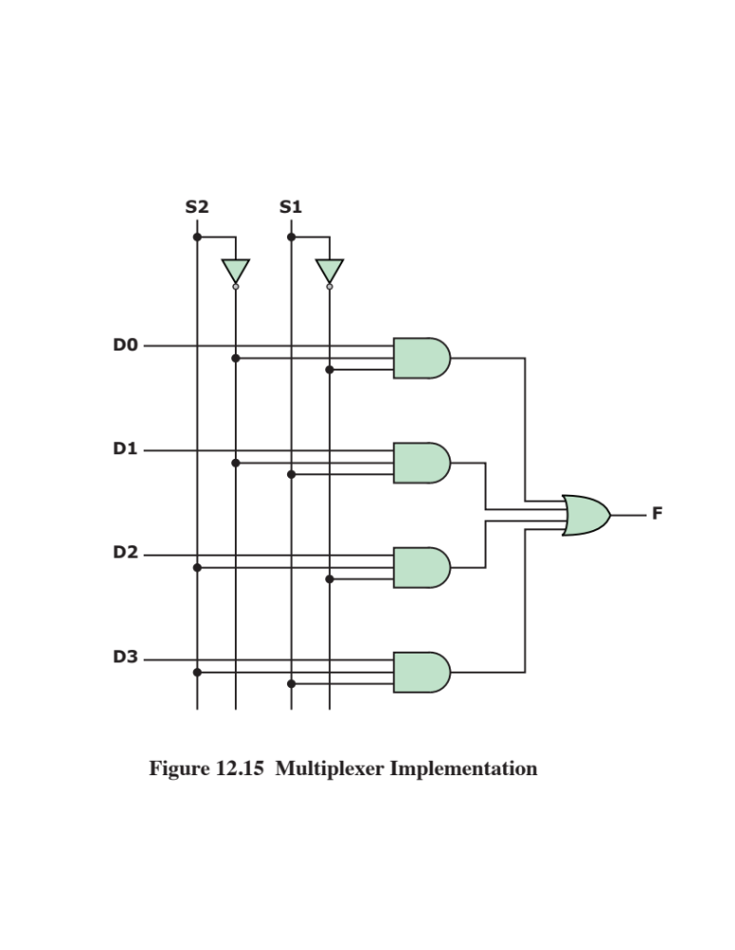
Muliplexer Implementation

Slide 12
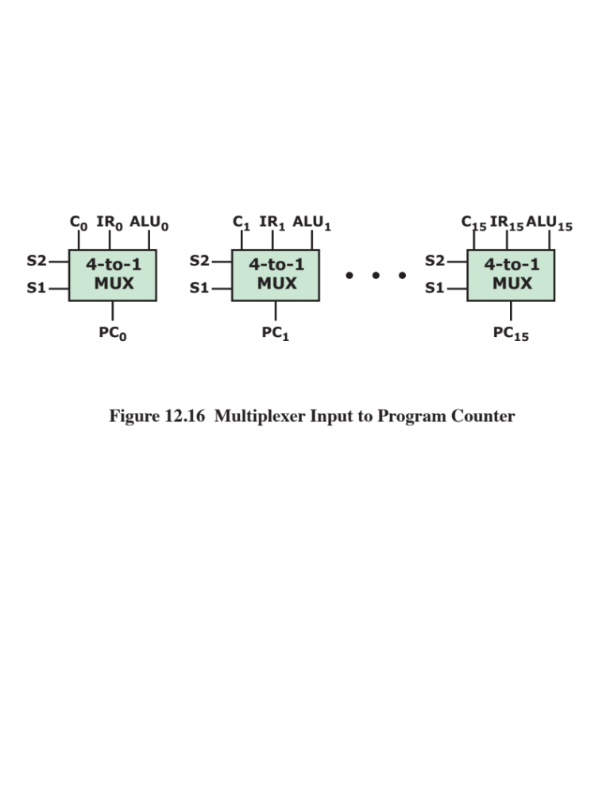
Multiplexer uses
Used to control routing of data and signals
Example: Program Counter (PC) register
  Binary value if PC incremented
  Instruction register if branch instruction executed
  Output from ALU (jumping a number of memory locations to a new address)

Slide 13
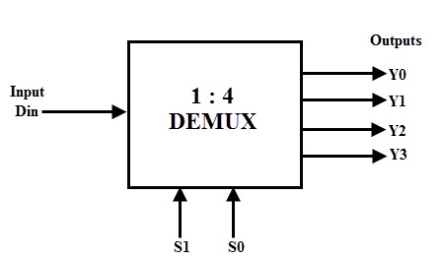
Demultiplexer (DEMUX)
A demultiplexer does the opposite
Selects output path
  S inputs determine which output line the input is sent to

Slide 14
Exercise: 2-to-1 multiplexer
Use https://logic.ly/demo or pen and paper to design a 2-to-1 multiplexer
Hint: very similar to slide 50 of last lecture.
D0
2-to-1
MUX
F
D1
S | F
0 | D0
1 | D1
S

Slide 15
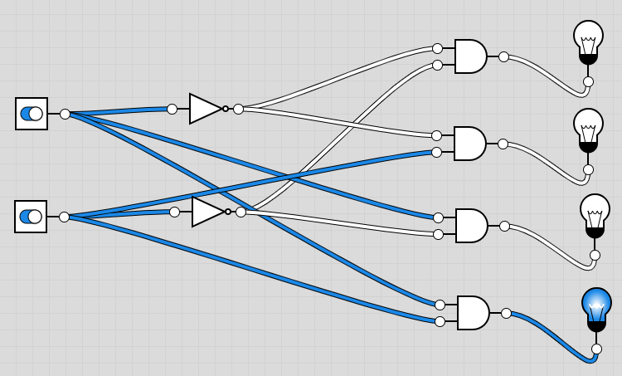
Decoder
A circuit with:
  n inputs
  2^{n} outputs
Determines output line based on inputs
2-to-4 decoder

Slide 16
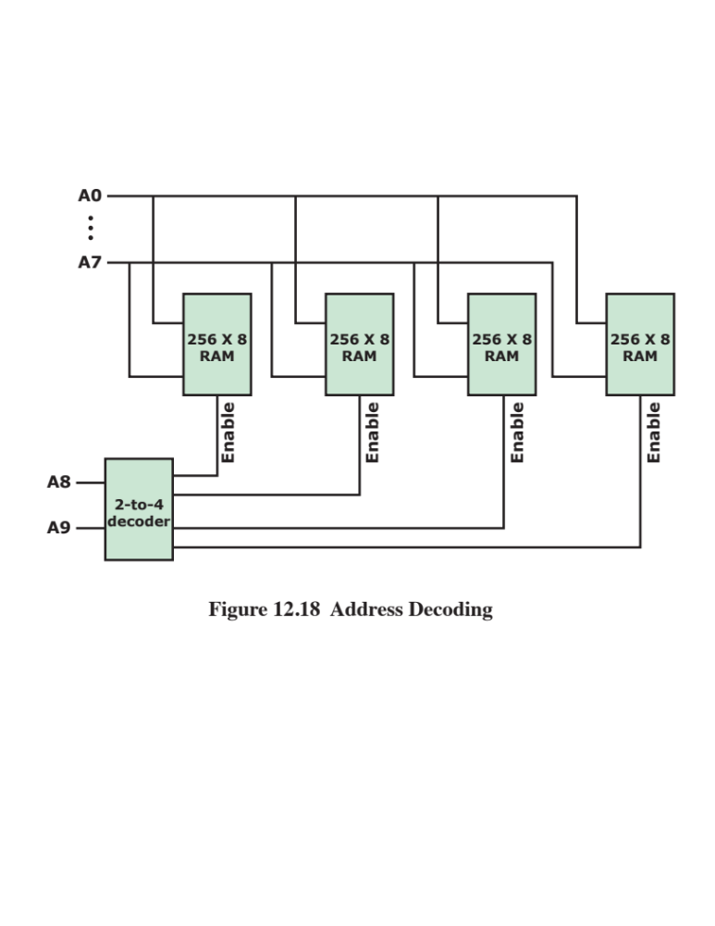
Decoder Use
Example: Address Decoding
Address Space
10-bit address
  2 bits to select chip
  8 bits to select location in chip
Address | Chip
0000 – 00FF | 0
0100 – 01FF | 1
0200 – 02FF | 2
0300 – 03FF | 3

Slide 17
Exercise: 1-to-2 decoder
Use https://logic.ly/demo or pen and paper to design a 1-to-2 decoder
  If input is 0, switch on bulb 1, turn off bulb 2
  If input is 1, turn off bulb 1, switch on bulb 2

Slide 18
Adder
An adder is a circuit which adds two bit and outputs the sum and carry bits.
Remember binary addition
  0 + 0 = 0
  0 + 1 = 1
  1 + 0 = 1
  1 + 1 = 10 (value 0 plus carry 1)
A | B | Sum | Carry
0 | 0 | 0 | 0
0 | 1 | 1 | 0
1 | 0 | 1 | 0
1 | 1 | 0 | 1

Slide 19
Exercise: 1-bit Half Adder
Using https://logic.ly/demo or pen and paper, design a circuit which implements this truth table:
It should have 2 inputs, A and B, and 2 outputs, Sum and Carry.
Hint: look at the truth tables for Sum and Carry. Which logical operators are they the same as?
A | B | Sum | Carry
0 | 0 | 0 | 0
0 | 1 | 1 | 0
1 | 0 | 1 | 0
1 | 1 | 0 | 1

Slide 20
Full 1-bit Adder
This should have 3 inputs
  A
  B
  CarryIn
2 outputs
  Sum
  CarryOut
A | B | C_{in} | Sum | C_{out}
0 | 0 | 0 | 0 | 0
0 | 1 | 0 | 1 | 0
1 | 0 | 0 | 1 | 0
1 | 1 | 0 | 0 | 1
0 | 0 | 1 | 1 | 0
0 | 1 | 1 | 0 | 1
1 | 0 | 1 | 0 | 1
1 | 1 | 1 | 1 | 1

Slide 21
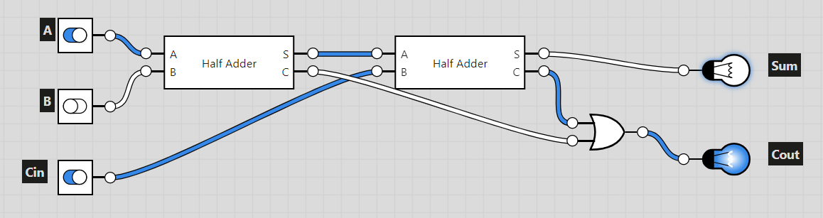
Full Adder Circuit
A full adder can be implemented with two half adders.

Slide 22
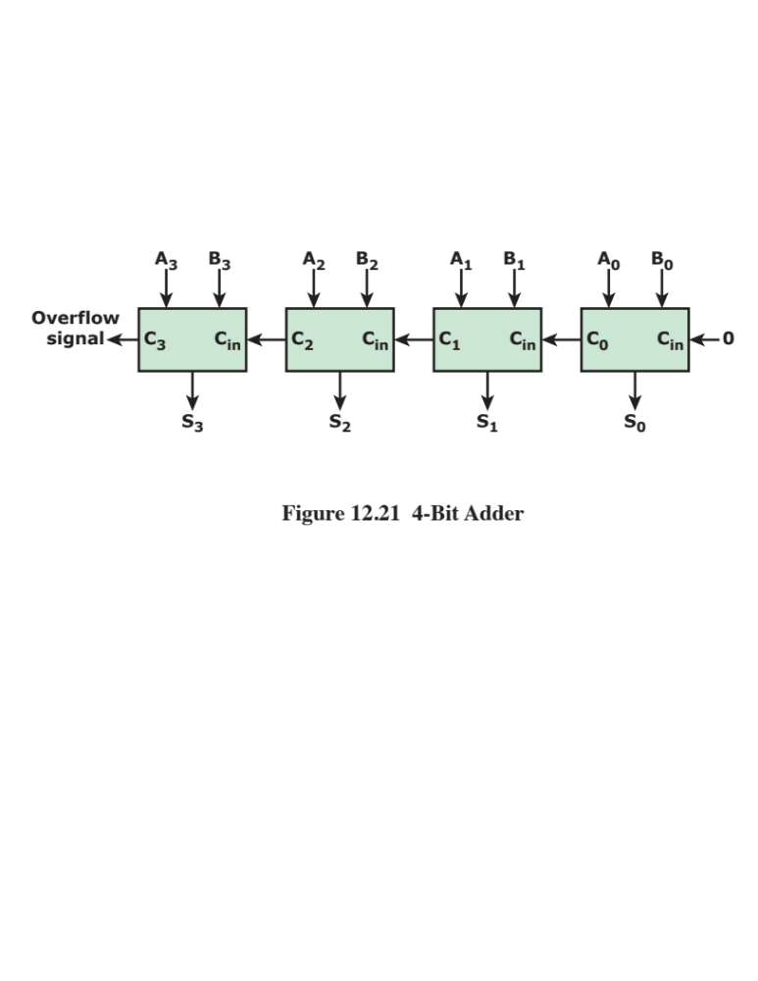
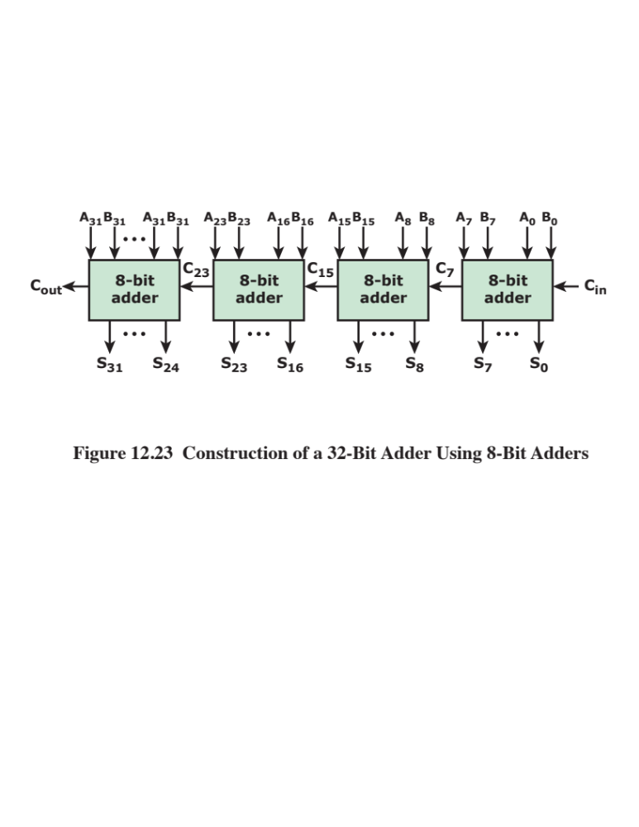
Multibit adders
4-bit adder built from 1-bit full adders
32-bit adder built from 8-bit full adders

Slide 23
Boolean Algebraic Laws

Slide 24
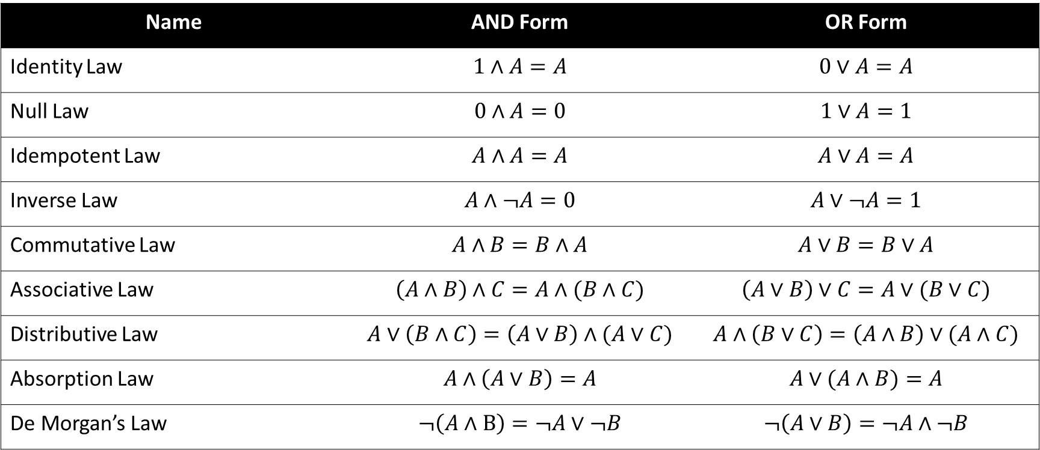
Boolean Algebraic Laws
Name | AND Form | OR Form
Identity Law | $$1∧A=A$$ | $$0∨A=A$$
Null Law | $$0∧A=0$$ | $$1∨A=1$$
Idempotent Law | $$A∧A=A$$ | $$A∨A=A$$
Inverse Law | $$A∧¬A=0$$ | $$A∨¬A=1$$
Commutative Law | $$A∧B=B∧A$$ | $$A∨B=B∨A$$
Associative Law | $$\left(A∧B\right)∧C=A∧(B∧C)$$ | $$\left(A∨B\right)∨C=A∨(B∨C)$$
Distributive Law | $$A∨\left(B∧C\right)=\left(A∨B\right)∧(A∨C)$$ | $$A∧\left(B∨C\right)=\left(A∧B\right)∨(A∧C)$$
Absorption Law | $$A∧\left(A∨B\right)=A$$ | $$A∨(A∧B)=A$$
De Morgan’s Law | $$¬\left(A∧B\right)=¬A∨¬B$$ | $$¬\left(A∨B\right)=¬A∧¬B$$

Slide 25
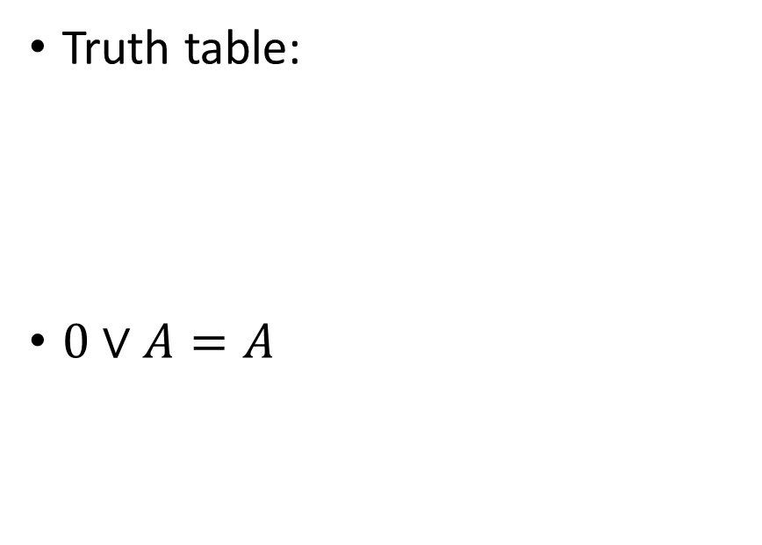
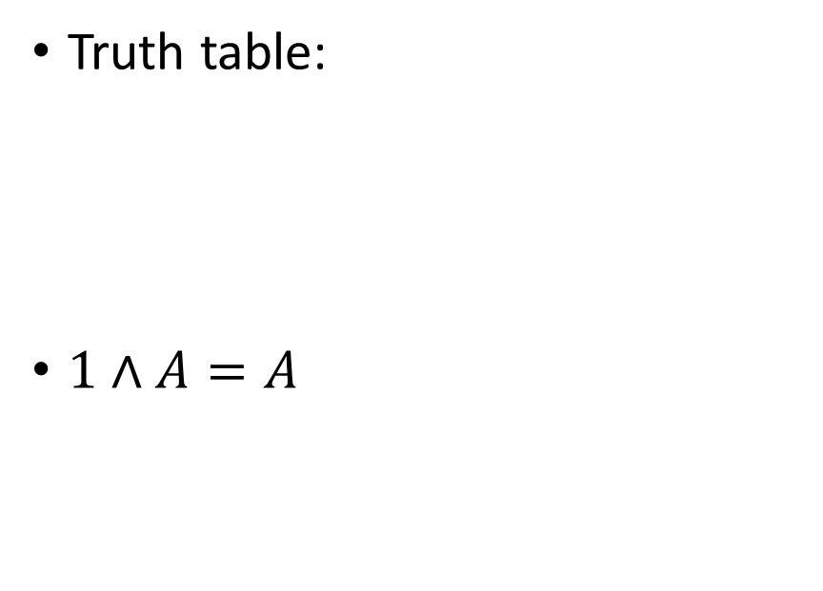
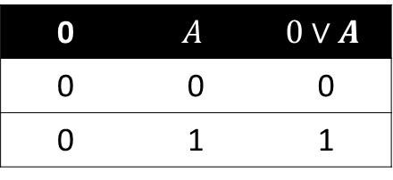
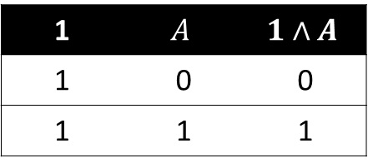
Identity Law
AND Form
OR Form
Truth table:
$1∧A=A$
Truth table:
$0∨A=A$
1 | $$A$$ | $$1∧A$$
1 | 0 | 0
1 | 1 | 1
0 | $$A$$ | $$0∨A$$
0 | 0 | 0
0 | 1 | 1

Slide 26
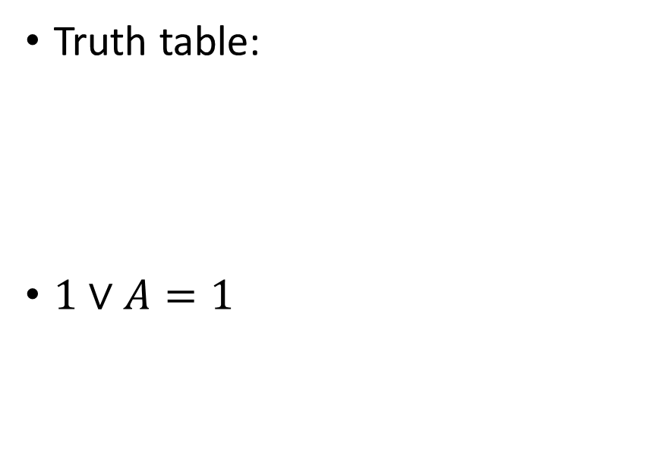
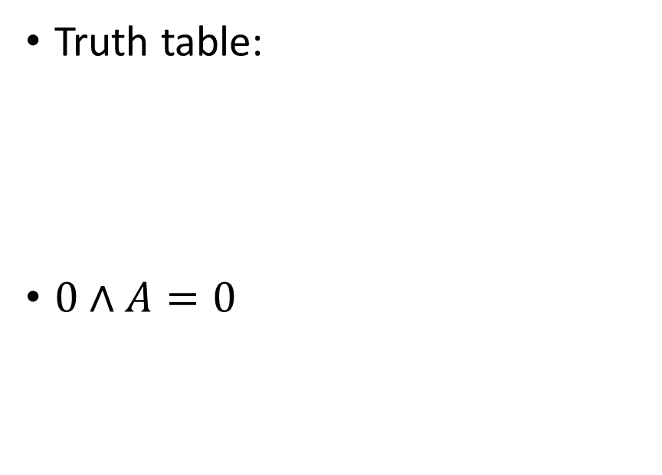
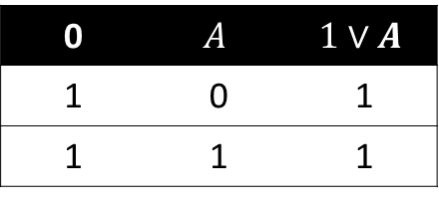
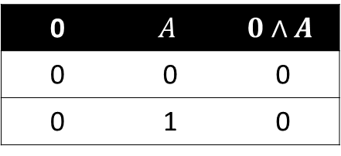
Null Law
AND Form
OR Form
Truth table:
$0∧A=0$
Truth table:
$1∨A=1$
0 | $$A$$ | $$0∧A$$
0 | 0 | 0
0 | 1 | 0
0 | $$A$$ | $$1∨A$$
1 | 0 | 1
1 | 1 | 1

Slide 27
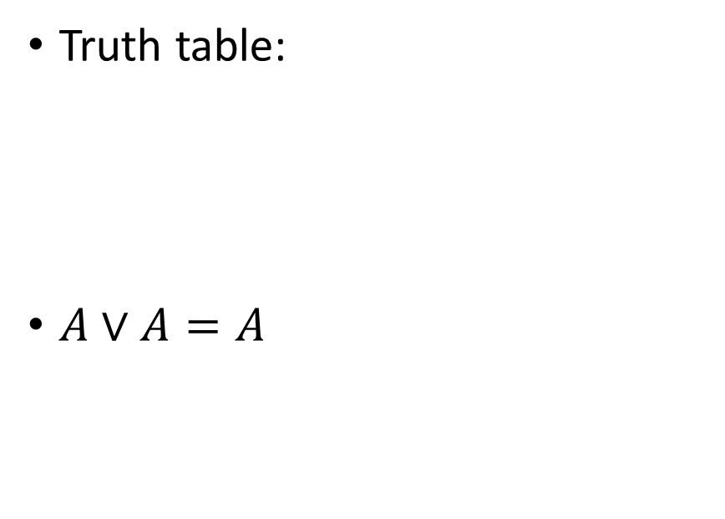
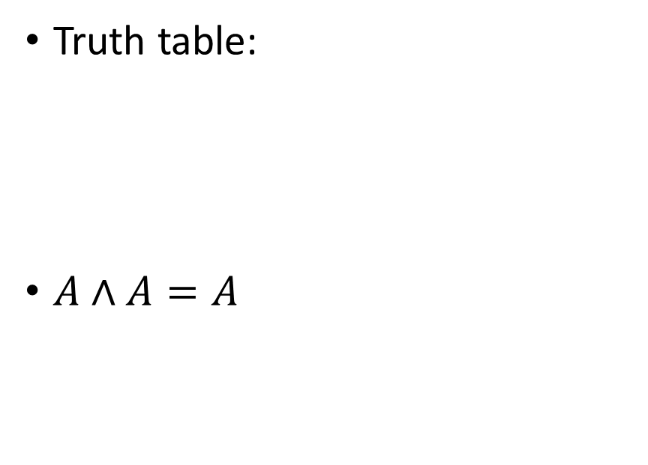
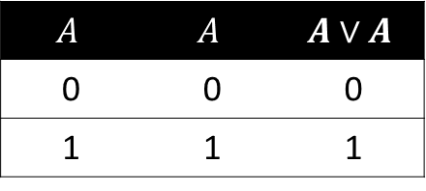
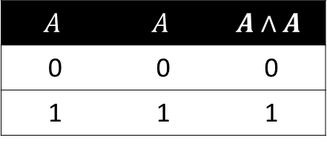
Idempotent Law
AND Form
OR Form
Truth table:
$A∧A=A$
Truth table:
$A∨A=A$
$$A$$ | $$A$$ | $$A∧A$$
0 | 0 | 0
1 | 1 | 1
$$A$$ | $$A$$ | $$A∨A$$
0 | 0 | 0
1 | 1 | 1

Slide 28
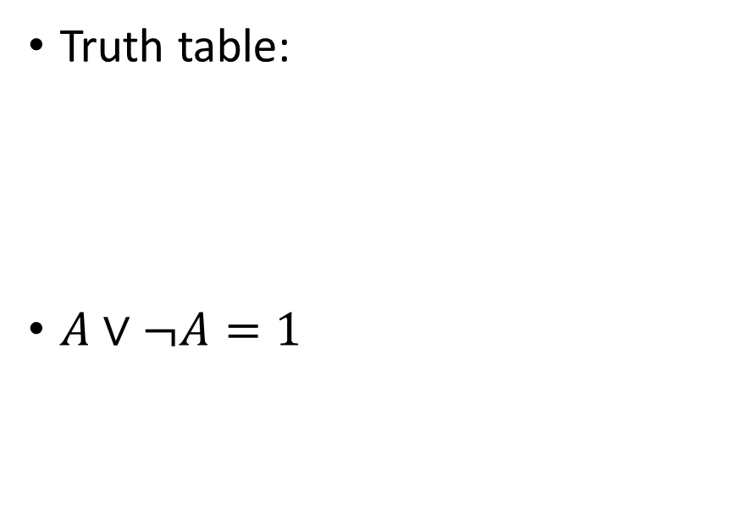
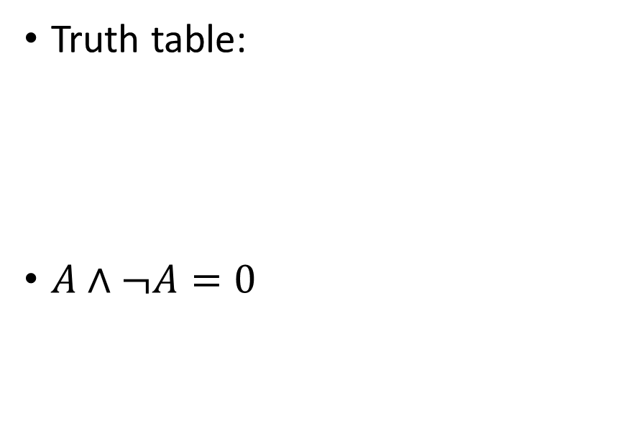
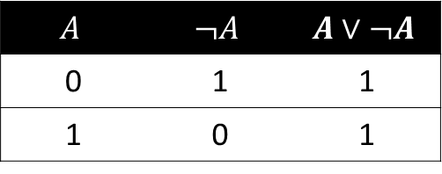
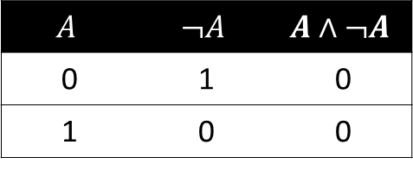
Inverse Law
AND Form
OR Form
Truth table:
$A∧¬A=0$
Truth table:
$A∨¬A=1$
$$A$$ | $$¬A$$ | $$A∧¬A$$
0 | 1 | 0
1 | 0 | 0
$$A$$ | $$¬A$$ | $$A∨¬A$$
0 | 1 | 1
1 | 0 | 1

Slide 29
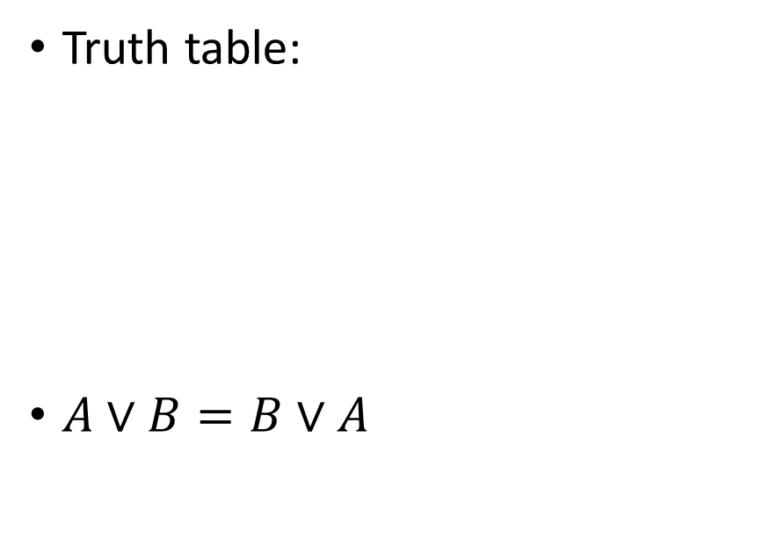
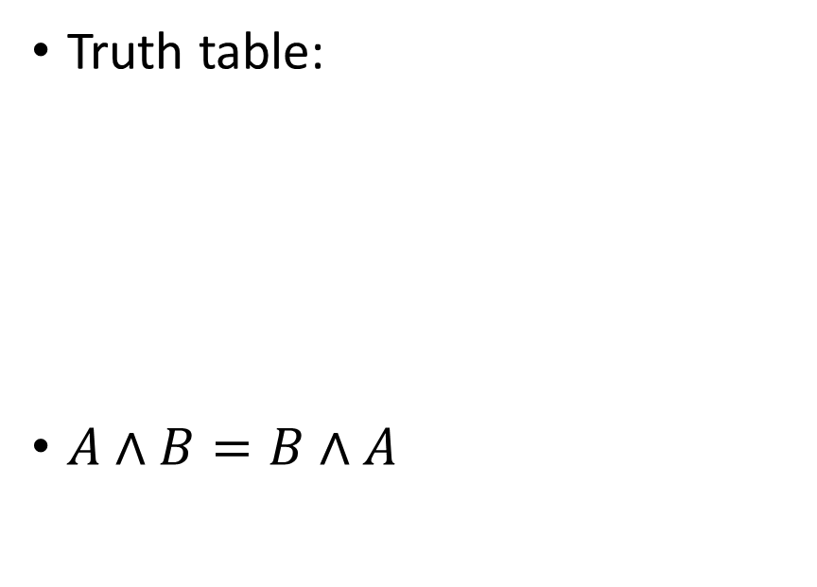
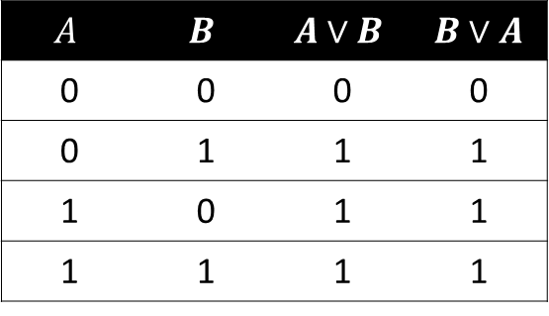
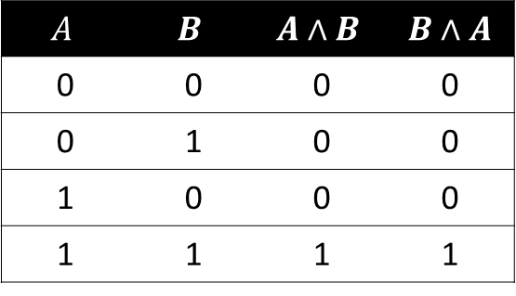
Commutative Law
AND Form
OR Form
Truth table:
$A∧B=B∧A$
Truth table:
$A∨B=B∨A$
$$A$$ | $$B$$ | $$A∧B$$ | $B∧A$
0 | 0 | 0 | 0
0 | 1 | 0 | 0
1 | 0 | 0 | 0
1 | 1 | 1 | 1
$$A$$ | $$B$$ | $$A∨B$$ | $B∨A$
0 | 0 | 0 | 0
0 | 1 | 1 | 1
1 | 0 | 1 | 1
1 | 1 | 1 | 1

Slide 30
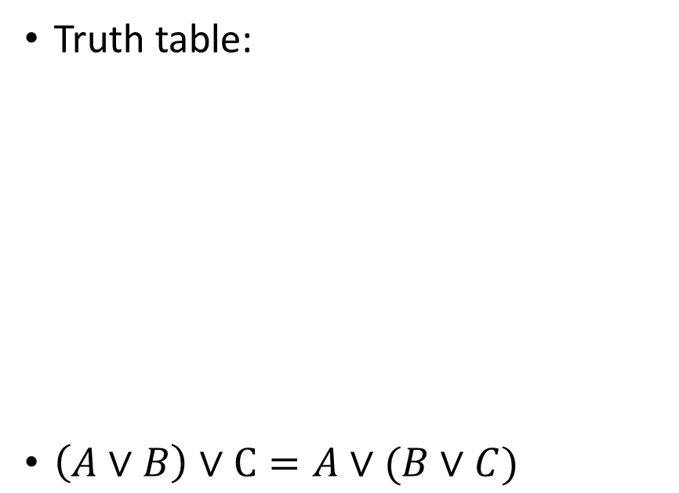
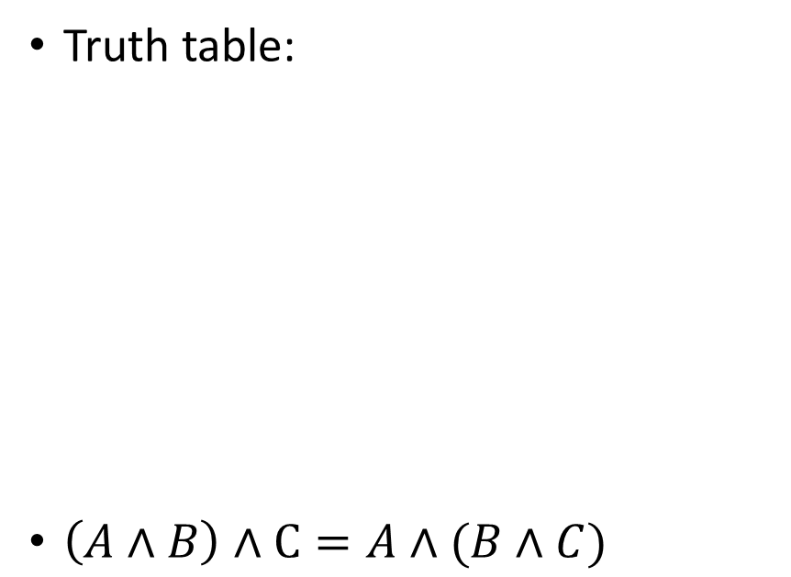
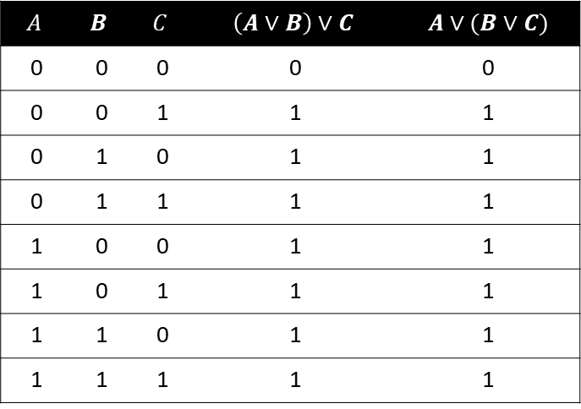

Associative Law
AND Form
OR Form
Truth table:
$\left(A∧B\right)∧C=A∧(B∧C)$
Truth table:
$\left(A∨B\right)∨C=A∨(B∨C)$
$$A$$ | $$B$$ | $$C$$ | $$\left(A∧B\right)∧C$$ | $A∧(B∧C)$
0 | 0 | 0 | 0 | 0
0 | 0 | 1 | 0 | 0
0 | 1 | 0 | 0 | 0
0 | 1 | 1 | 0 | 0
1 | 0 | 0 | 0 | 0
1 | 0 | 1 | 0 | 0
1 | 1 | 0 | 0 | 0
1 | 1 | 1 | 1 | 1
$$A$$ | $$B$$ | $$C$$ | $$\left(A∨B\right)∨C$$ | $A∨(B∨C)$
0 | 0 | 0 | 0 | 0
0 | 0 | 1 | 1 | 1
0 | 1 | 0 | 1 | 1
0 | 1 | 1 | 1 | 1
1 | 0 | 0 | 1 | 1
1 | 0 | 1 | 1 | 1
1 | 1 | 0 | 1 | 1
1 | 1 | 1 | 1 | 1

Slide 31
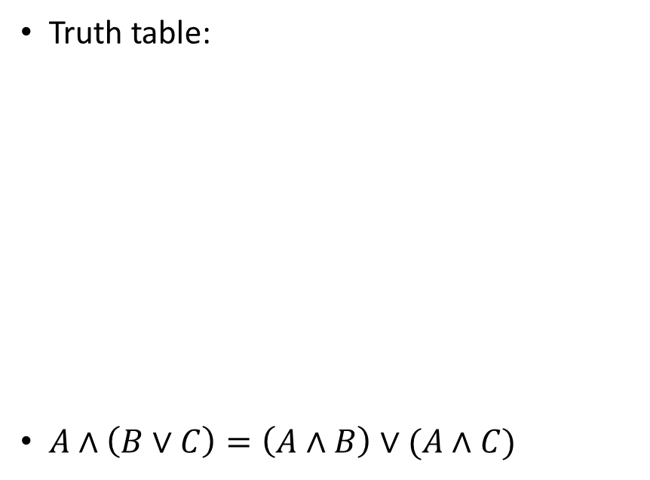
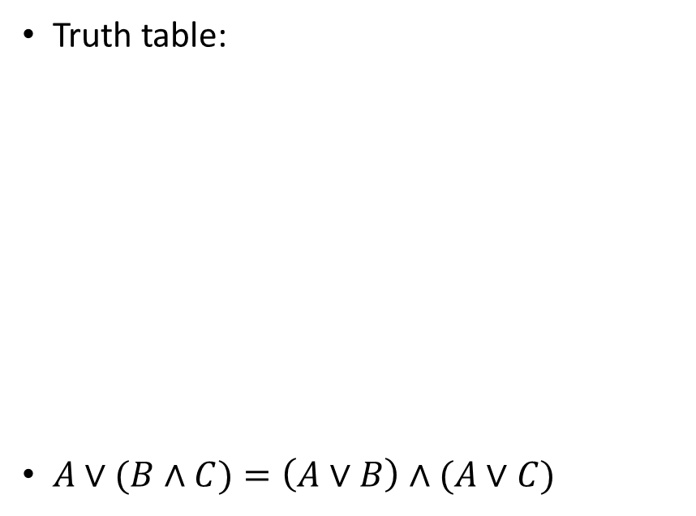
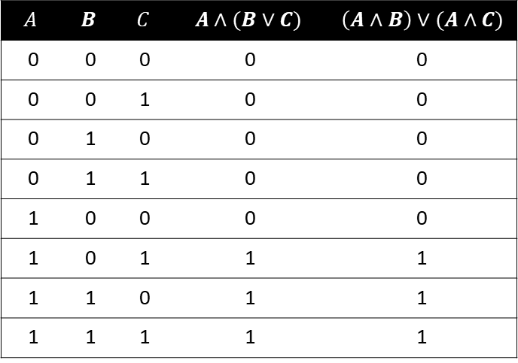

Distributive Law
AND Form
OR Form
Truth table:
$A∨(B∧C)=\left(A∨B\right)∧(A∨C)$
Truth table:
$A∧\left(B∨C\right)=\left(A∧B\right)∨(A∧C)$
$$A$$ | $$B$$ | $$C$$ | $$A∨(B∧C)$$ | $\left(A∨B\right)∧(A∨C)$
0 | 0 | 0 | 0 | 0
0 | 0 | 1 | 0 | 0
0 | 1 | 0 | 0 | 0
0 | 1 | 1 | 1 | 1
1 | 0 | 0 | 1 | 1
1 | 0 | 1 | 1 | 1
1 | 1 | 0 | 1 | 1
1 | 1 | 1 | 1 | 1
$$A$$ | $$B$$ | $$C$$ | $$A∧(B∨C)$$ | $\left(A∧B\right)∨(A∧C)$
0 | 0 | 0 | 0 | 0
0 | 0 | 1 | 0 | 0
0 | 1 | 0 | 0 | 0
0 | 1 | 1 | 0 | 0
1 | 0 | 0 | 0 | 0
1 | 0 | 1 | 1 | 1
1 | 1 | 0 | 1 | 1
1 | 1 | 1 | 1 | 1

Slide 32
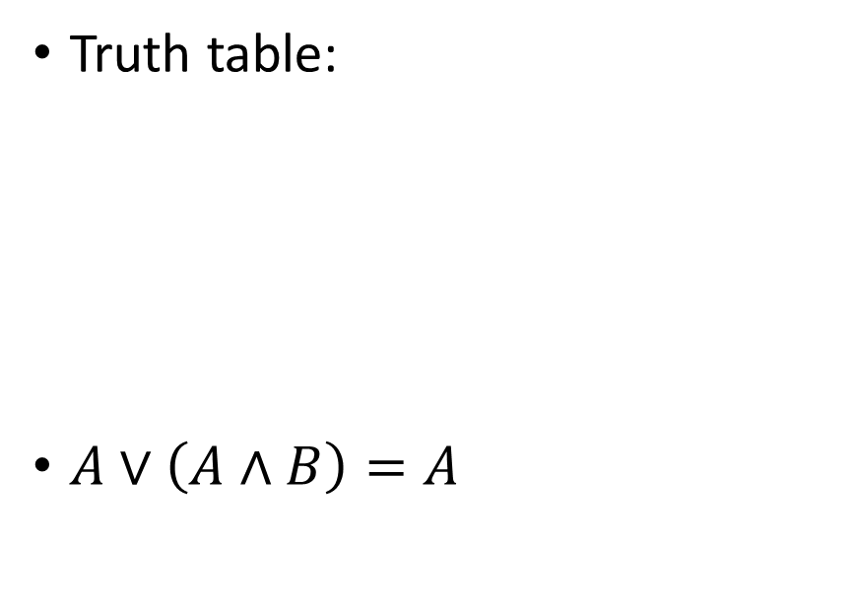
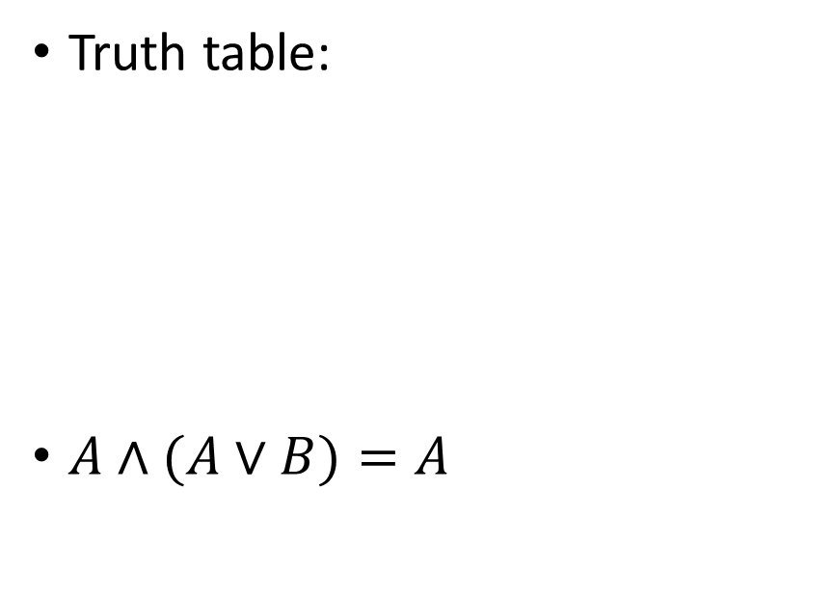
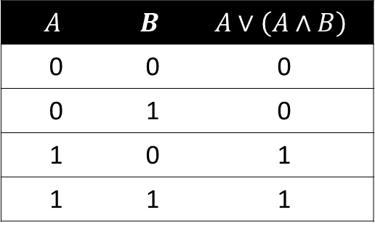

Absorption Law
AND Form
OR Form
Truth table:
$A∧(A∨B)=A$
Truth table:
$A∨\left(A∧B\right)=A$
$$A$$ | $$B$$ | $$A∧\left(A∨B\right)$$
0 | 0 | 0
0 | 1 | 0
1 | 0 | 1
1 | 1 | 1
$$A$$ | $$B$$ | $$A∨\left(A∧B\right)$$
0 | 0 | 0
0 | 1 | 0
1 | 0 | 1
1 | 1 | 1

Slide 33
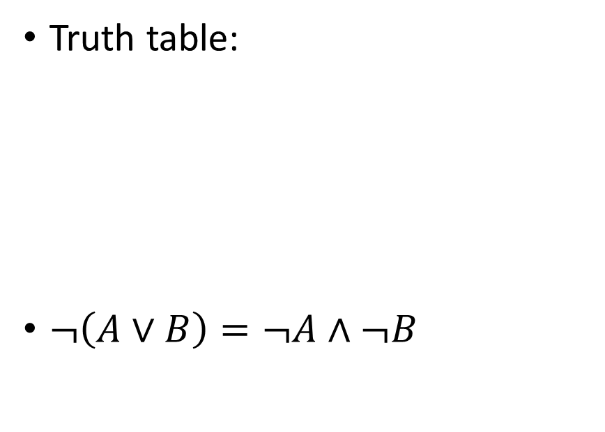
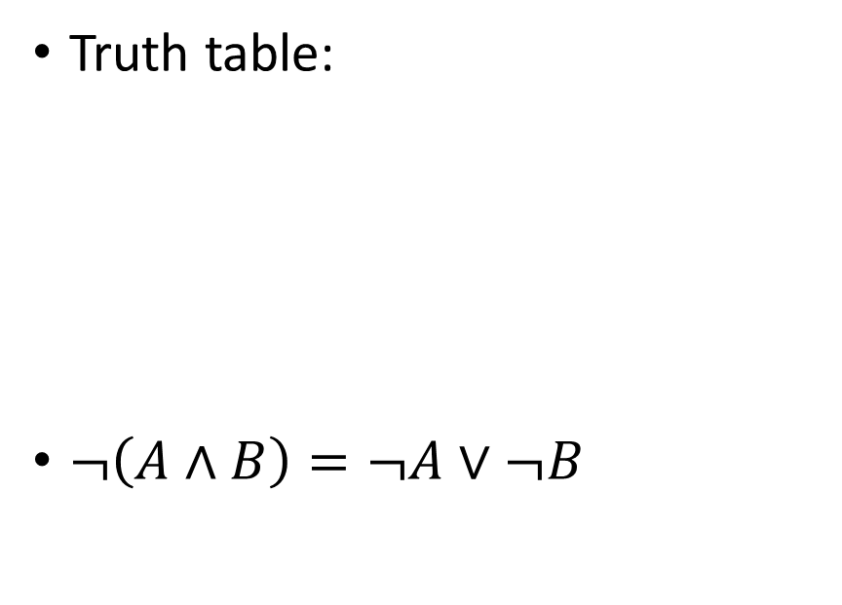
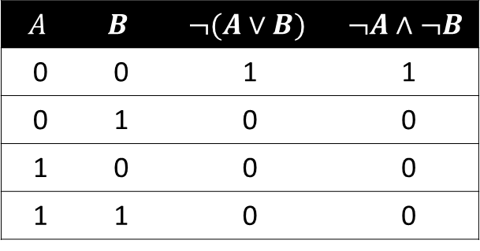
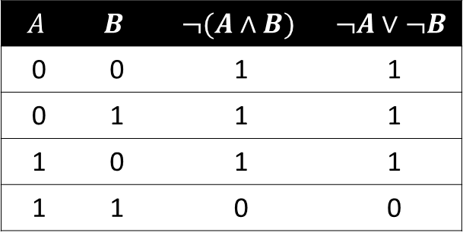
De Morgan’s Law
AND Form
OR Form
Truth table:
$¬\left(A∧B\right)=¬A∨¬B$
Truth table:
$¬\left(A∨B\right)=¬A∧¬B$
$$A$$ | $$B$$ | $$¬(A∧B)$$ | $$¬A∨¬B$$
0 | 0 | 1 | 1
0 | 1 | 1 | 1
1 | 0 | 1 | 1
1 | 1 | 0 | 0
$$A$$ | $$B$$ | $$¬(A∨B)$$ | $$¬A∧¬B$$
0 | 0 | 1 | 1
0 | 1 | 0 | 0
1 | 0 | 0 | 0
1 | 1 | 0 | 0

Slide 34
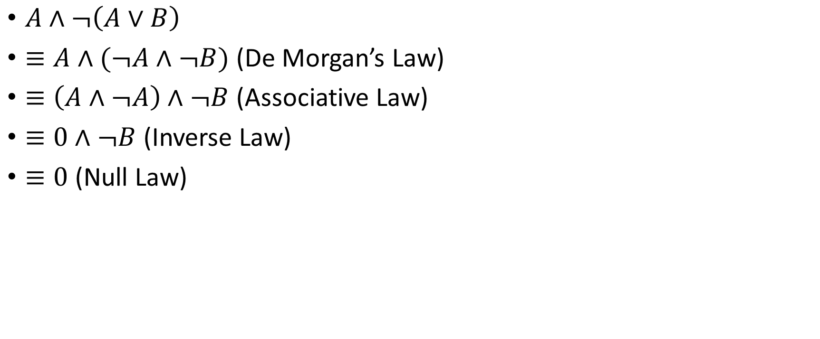
Example: simplifying Boolean expressions
$A∧¬\left(A∨B\right)$
$≡A∧(¬A∧¬B)$ (De Morgan’s Law)
$≡\left(A∧¬A\right)∧¬B$ (Associative Law)
$≡0∧¬B$ (Inverse Law)
$≡0$ (Null Law)

Slide 35
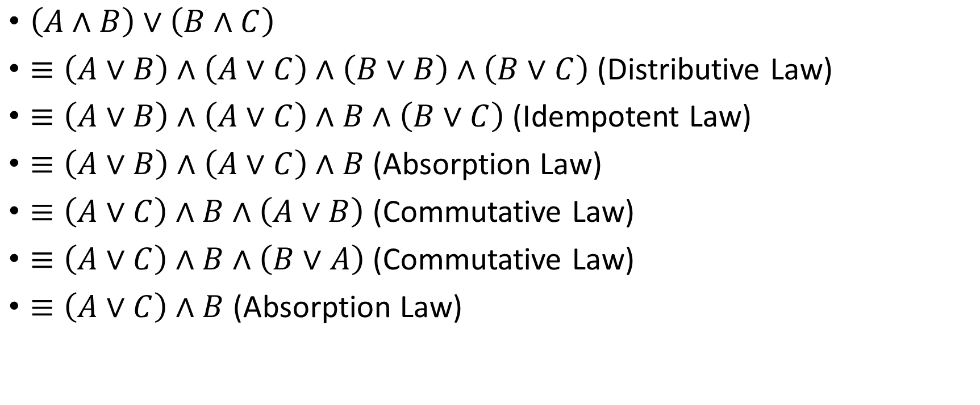
Example: simplifying Boolean expressions
$\left(A∧B\right)∨\left(B∧C\right)$
$≡\left(A∨B\right)∧\left(A∨C\right)∧\left(B∨B\right)∧\left(B∨C\right)$ (Distributive Law)
$≡\left(A∨B\right)∧\left(A∨C\right)∧B∧\left(B∨C\right)$ (Idempotent Law)
$≡\left(A∨B\right)∧\left(A∨C\right)∧B$ (Absorption Law)
$≡\left(A∨C\right)∧B∧\left(A∨B\right)$ (Commutative Law)
$≡\left(A∨C\right)∧B∧\left(B∨A\right)$ (Commutative Law)
$≡\left(A∨C\right)∧B$ (Absorption Law)

Slide 36
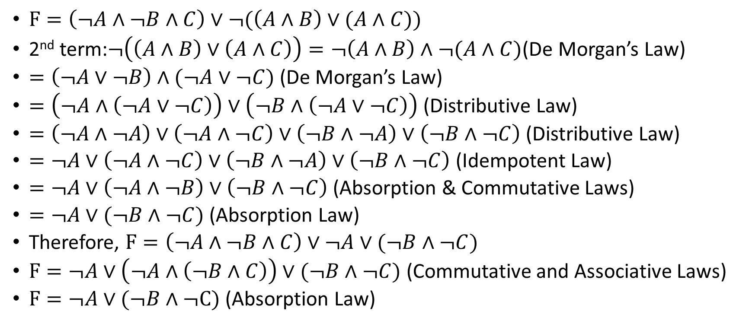
Examples: Simplifying Boolean Expressions
$F=\left(¬A∧¬B∧C\right)∨¬(\left(A∧B\right)∨(A∧C))$
2nd term:$¬\left(\left(A∧B\right)∨\left(A∧C\right)\right)=¬\left(A∧B\right)∧¬(A∧C)$(De Morgan’s Law)
$=\left(¬A∨¬B\right)∧(¬A∨¬C)$(De Morgan’s Law)
$=\left(¬A∧\left(¬A∨¬C\right)\right)∨\left(¬B∧\left(¬A∨¬C\right)\right)$ (Distributive Law)
$=\left(¬A∧¬A\right)∨\left(¬A∧¬C\right)∨\left(¬B∧¬A\right)∨\left(¬B∧¬C\right)$(Distributive Law)
$=¬A∨\left(¬A∧¬C\right)∨\left(¬B∧¬A\right)∨\left(¬B∧¬C\right)$ (Idempotent Law)
$=¬A∨\left(¬A∧¬B\right)∨\left(¬B∧¬C\right)$ (Absorption & Commutative Laws)
$=¬A∨(¬B∧¬C)$ (Absorption Law)
Therefore, $F=\left(¬A∧¬B∧C\right)∨¬A∨(¬B∧¬C)$
$F=¬A∨\left(¬A∧\left(¬B∧C\right)\right)∨(¬B∧¬C)$ (Commutative and Associative Laws)
$F=¬A∨(¬B∧¬C)$ (Absorption Law)

Slide 37

Exercise
Simplify the following expressions using Boolean algebraic laws:
$F=A∨¬\left(B∧A\right)$
$F=\left(A∨B\right)∧\left(A∨C\right)$

Slide 38
The Expressive Power of NAND

Slide 39




The Expressive Power of NAND
A | B | $$A\overline{∧}B$$
0 | 0 | 1
0 | 1 | 1
1 | 0 | 1
1 | 1 | 0
A | B | $$A∧B$$
0 | 0 | 0
0 | 1 | 0
1 | 0 | 0
1 | 1 | 1
A | B | $$A∨B$$
0 | 0 | 0
0 | 1 | 1
1 | 0 | 1
1 | 1 | 1
A | $$¬A$$
0 | 1
1 | 0
Any logical operator can be expressed using NANDs only

Slide 40




Example: NOT
$¬A≡A\overline{∧}A$
A | A | $$A\overline{∧}A$$
0 | 0 | 1
1 | 1 | 0
A | $$¬A$$
0 | 1
1 | 0

Slide 41


Example: AND
$A\overline{∧}B≡¬(A∧B)$
Therefore, $A∧B≡¬(A\overline{∧}B)$
But NOT is not a NAND??!!
Remember from previous slide $¬A≡A\overline{∧}A$
Hence, $A∧B≡¬\left(A\overline{∧}B\right)≡(A\overline{∧}B)\overline{∧}(A\overline{∧}B)$

Slide 42


Example: OR
$¬(A∨B)≡¬A∧¬B$ (DeMorgan’s Law)
Therefore $A∨B≡¬(¬A∧¬B)$
$≡¬\left(¬\left(¬A\overline{∧}¬B\right)\right)$ (Remember, $A\overline{∧}B≡¬(A∧B)$
$≡¬A\overline{∧}¬B$
$≡(A\overline{∧}A)\overline{∧}(B\overline{∧}B)$ (Remember, $¬ A≡ A\overline{∧}A$)

Slide 43



Example: XOR
Observe that $A⊕B≡\left(A∨B\right)∧(A\overline{∧}B)$
$≡\left(A∧\left(A\overline{∧}B\right)\right)∨(B∧\left(A\overline{∧}B\right))$ (Distributive Law)
$≡¬\left(A\overline{∧}\left(A\overline{∧}B\right)\right)∨¬\left(B\overline{∧}\left(A\overline{∧}B\right)\right)$
$≡¬\left(\left(A\overline{∧}\left(A\overline{∧}B\right)\right)∧\left(B\overline{∧}\left(A\overline{∧}B\right)\right)\right)$ (De Morgan’s Law)
$≡\left(A\overline{∧}\left(A\overline{∧}B\right)\right)\overline{∧}\left(B\overline{∧}\left(A\overline{∧}B\right)\right)$
$$A$$ | $$B$$ | $$A⊕B$$
0 | 0 | 0
0 | 1 | 1
1 | 0 | 1
1 | 1 | 0
$$A$$ | $$B$$ | $$A∨B$$ | $$∧$$ | $$A\overline{∧}B$$
0 | 0 | 0 | 0 | 1
0 | 1 | 1 | 1 | 1
1 | 0 | 1 | 1 | 1
1 | 1 | 1 | 0 | 0

Slide 44

Exercise
Implement a circuit for XOR using only NAND gates by translating the expression from the previous slide:
$$A⊕B≡\left(A\overline{∧}\left(A\overline{∧}B\right)\right)\overline{∧}\left(B\overline{∧}\left(A\overline{∧}B\right)\right)$$
Create logical circuits for the following using only NAND gates:
  NOR ($\overline{∨}$) ($A\overline{∨}B≡¬(A∨B)$)
  XNOR ($⊙$) ($A⊙B≡¬(A⊕B)$)

Slide 45
Summary
Implementing Logic Gates in Electronics
Combinational Circuits
  Multiplexer
  Decoder
  Adder
Boolean Algebraic Laws
Expressive Power of NAND

